Slide 1
Quantum Boltzmann Machine
A study based on:
“Quantum Boltzmann Machine”
Mohammad H. Amin, et al.,
Phys. Rev. X 8, 021050 (2018)
Andrea De Cristofaro, Daniel Janjani

Slide 2
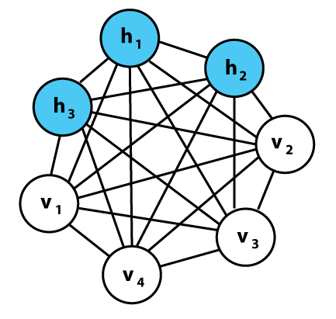

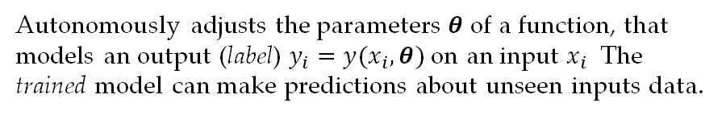
Quantum Machine Learning
How
01
Autonomously adjusts the parameters $θ$ of a function, that models an output (label) $y_{i}=y(x_{i}, θ)$ on an input $x_{i}$ The trained model can make predictions about unseen inputs data.
02
Quantum
Quantum computation can be exploited to achieve exponential speed-ups on some of the classical machine learning algorithms.​
A graphical rapresentation of a Boltzmann Machine.
03
Probabilistic modelling
The model aims to learn the data probability distribution $P_{v}^{data}$.

Slide 3
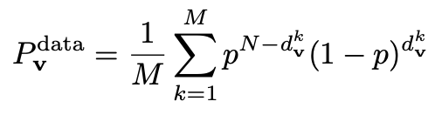
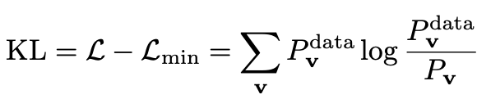

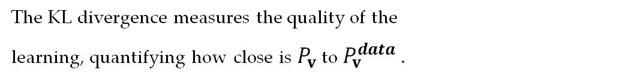
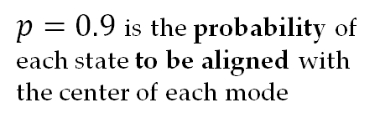
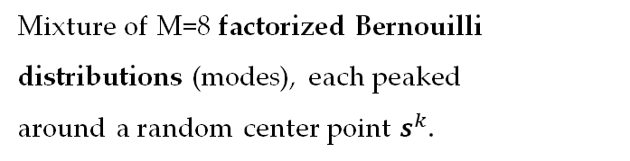
Training the model
$p=0.9$ is the probability of each state to be aligned with the center of each mode
Training data distribution
Mixture of M=8 factorized Bernouilli distributions (modes), each peaked
around a random center point $s^{k}$.
Kullback-Leibler divergence
$$KL=0⇐⇒ P_{v}=P_{v}^{data}$$
The KL divergence measures the quality of the
learning, quantifying how close is $P_{v}$ to $P_{v}^{data}$ .

Slide 4
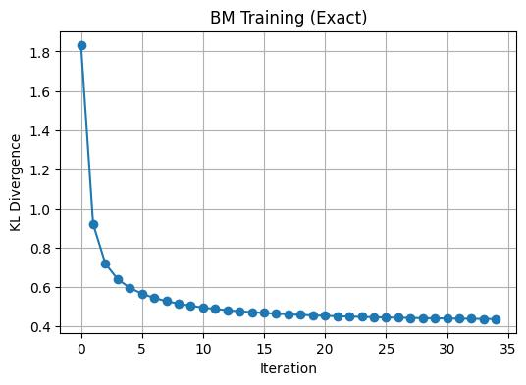
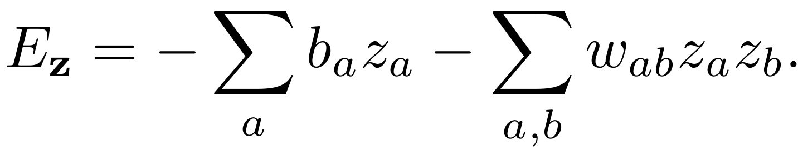
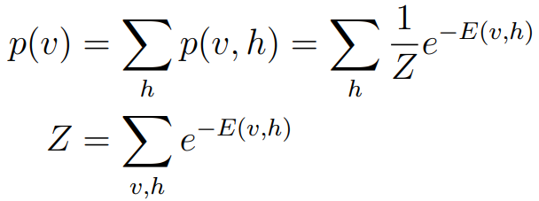
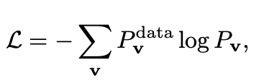


Boltzmann Machines
$$N=10, η=0.3$$
Ising energy model
Boltzmann distribution
Gradient descent technique
“Boltzmann machines are neural networks
used for generative machine learning”
[G.E. Hinton, 2012]

Slide 5
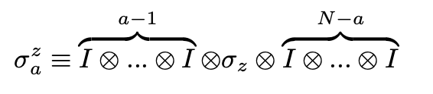
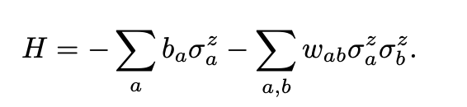
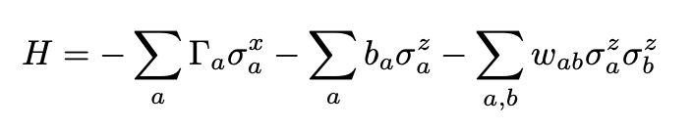
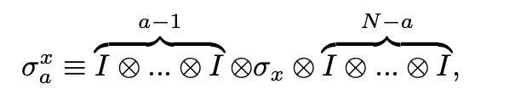
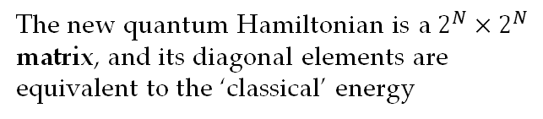
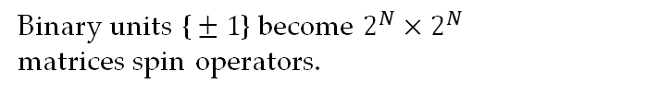
Quantum Boltzmann Machine (QBM)
Let’s make it quantum!
Qubits
Binary units $\text{\{}±1\text{\}}$ become $2^{N}×2^{N}$
matrices spin operators.
Hamiltonian
The new quantum Hamiltonian is a $2^{N}×2^{N}$ matrix, and its diagonal elements are equivalent to the ‘classical’ energy
Transverse field
A transverse field introducing non-diagonal elements to the Hamiltonian.

Slide 6

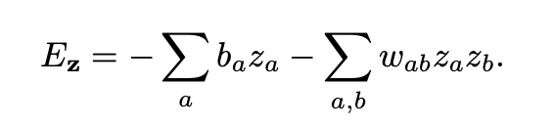
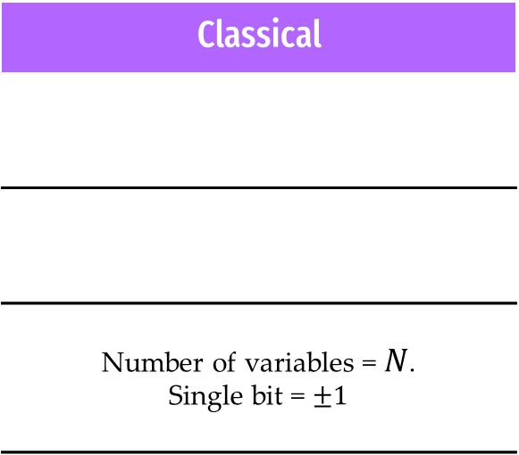
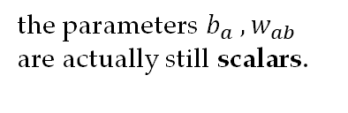
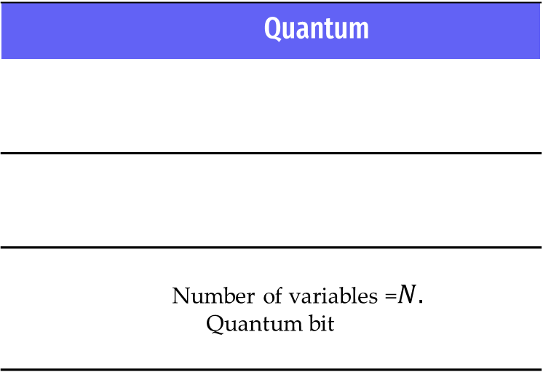
What changes? Can we talk about quantum machine learning?
Classical
Number of variables = $N$. Single bit = $±1$
Quantum
Number of variables =$N.$ Quantum bit
the parameters $b_{a} ,w_{ab}$
are actually still scalars.

Slide 7
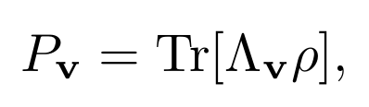
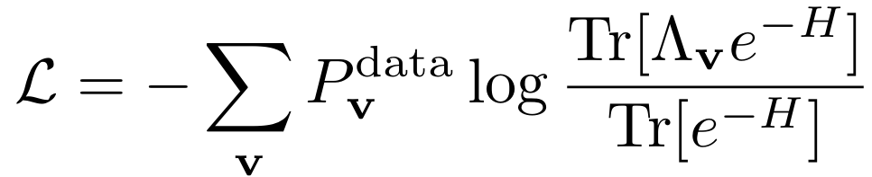
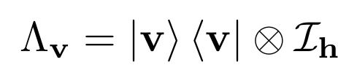
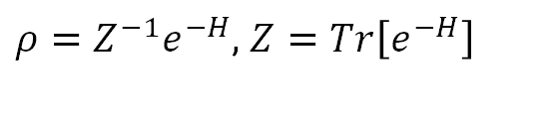
So what do the probabilities look like now?
Gibbs State
The density matrix depicts a quantum system in thermodynamic equilibrium:
$ρ=Z^{−1}e^{−H}$, $Z=Tr\left[e^{−H}\right]$
State Projector
New loss function

Slide 8
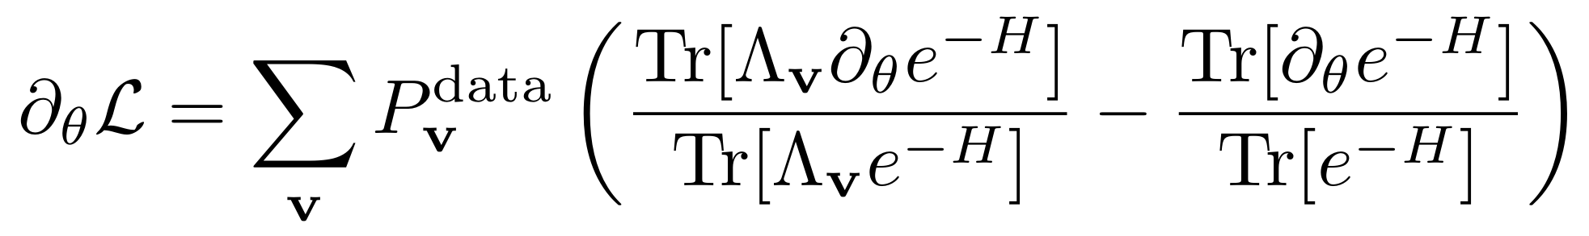
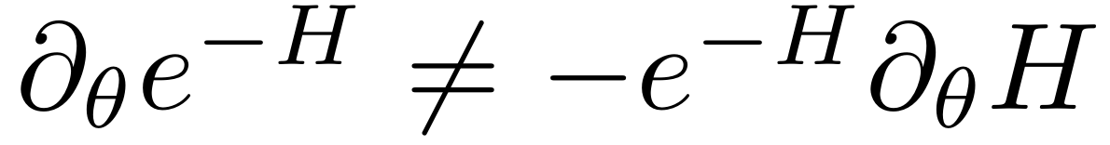
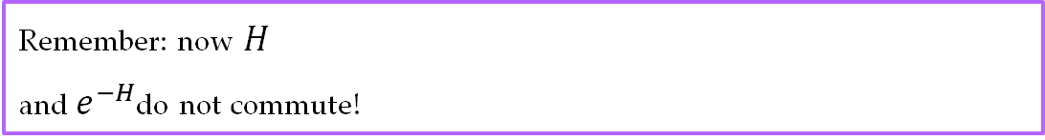
The math for QBM can be a little cumbersome…
Gradients
For each parameter we computed the exact
formula manually:
Remember: now $H$
and$e^{−H}$do not commute!

Slide 9
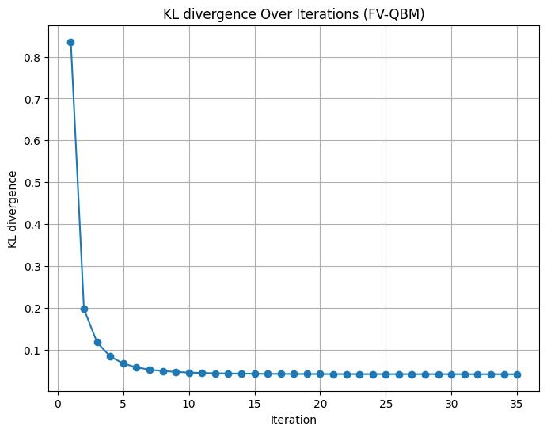
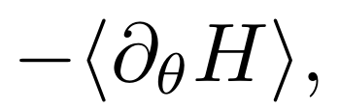
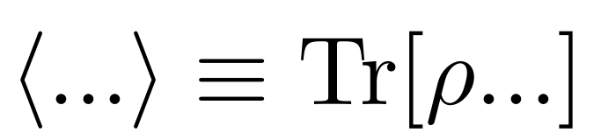
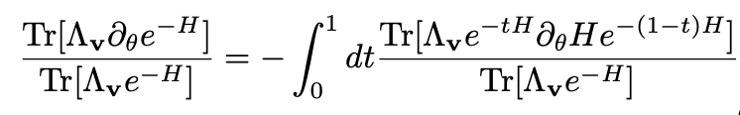


…leading to difficult computation
$$N=5, η=0.6$$
Doing the math, the previous terms of the gradient become:
Using Trotterization for $e^{−H}$:
The first term makes the training very impractical real fast:

Slide 10
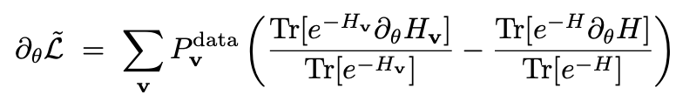
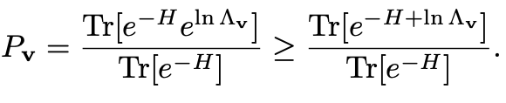
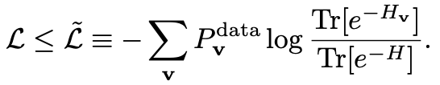

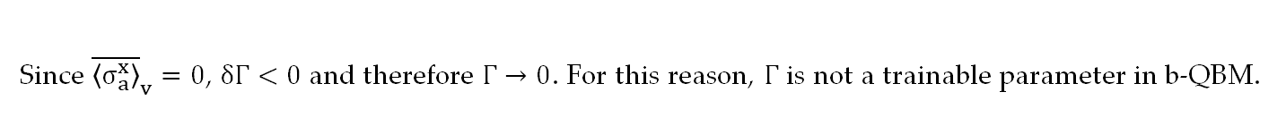

Bound-based QBM
The model introduces an upper-bound to the likelihood, and it is this upper-bound that is minimized. This approach is called bound-based QBM.
Golden-Thompson inequality
Upper-bound of the likelihood
Training $Γ$
Since ${\overline{\left\langle σ_{a}^{x}\right\rangle }}_{v}=0$, $δΓ<0$ and therefore $Γ→0$. For this reason, $Γ$ is not a trainable parameter in b-QBM.

Slide 11
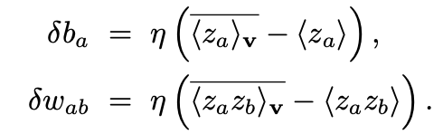
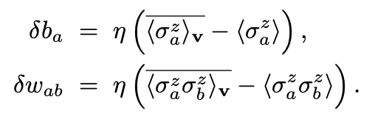
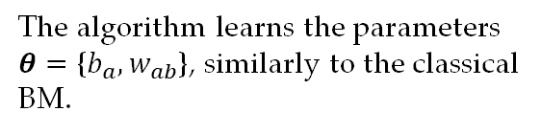
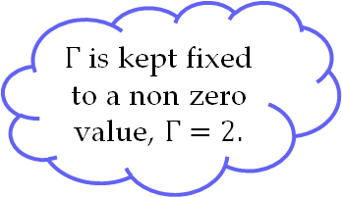
BM vs b-QBM
$Γ$ is kept fixed to a non zero value, $Γ=2.$
Comparison
BM
b-QBM
In the fully visible model the gradient steps are expressed as difference of two terms, also called 'positive' and 'negative' phases.
The algorithm learns the parameters $θ=\text{\{}b_{a}, w_{ab}\text{\}}\text{,}$ similarly to the classical BM.

Slide 12
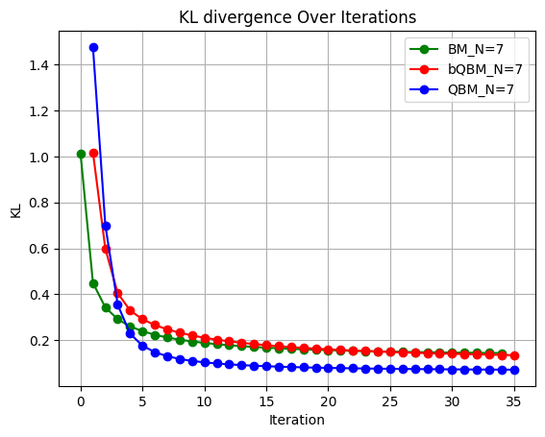
Final results
Similarly as in the reference paper, QBM learns KL values that are lower than BM and b-QBM.
Whether QBM can learn better than BM at larger sized are questions that still need to be answered.

Slide 13
Gradient update function
QBM optimization fails efforts
State projector
Sparse matrices
To conveniently express almost - empty large matrices
No significant speed up
Defined outside of the function, and called inside as a global variable
Almost 5x speed up!
Fortran
subroutine
+ Data inizialization
To compute the most time-demanding function
Even slower, possibly due to poor data structure conversion
Earth
Final results greatly affected
by initial parameters

Slide 14
Thank you for your attention

